Slide 1

Employee Details of GroupM Media Pvt Ltd With python (Pandas) coding

Slide 2
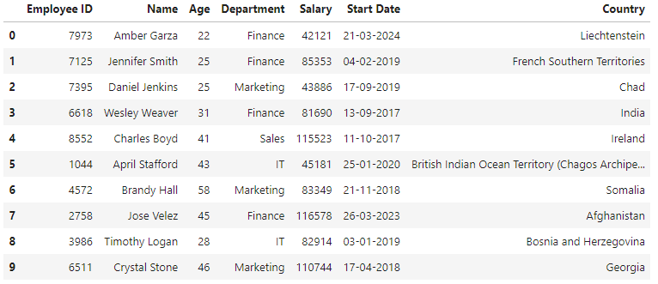
Dashboard
1. Basic Slicing and Indexing
(a) : Extract the first 10 rows of the dataset
Code :
Result :

Slide 3
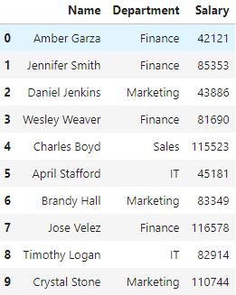
Dashboard
1. Basic Slicing and Indexing
(b) : Extract the Name, Department and Salary columns for the first 10 employees.
Code :
Result :

Slide 4

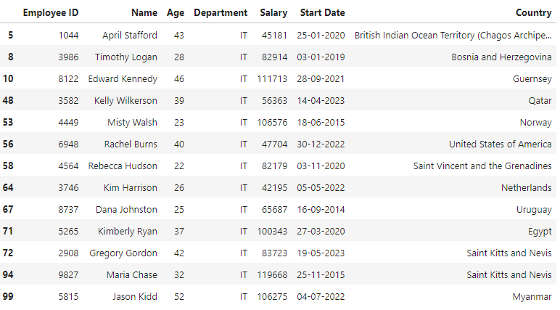
Dashboard
2.Filtering
(a) : Filter the dataset to find all employees who work in the "IT" department
Code :
Result :

Slide 5

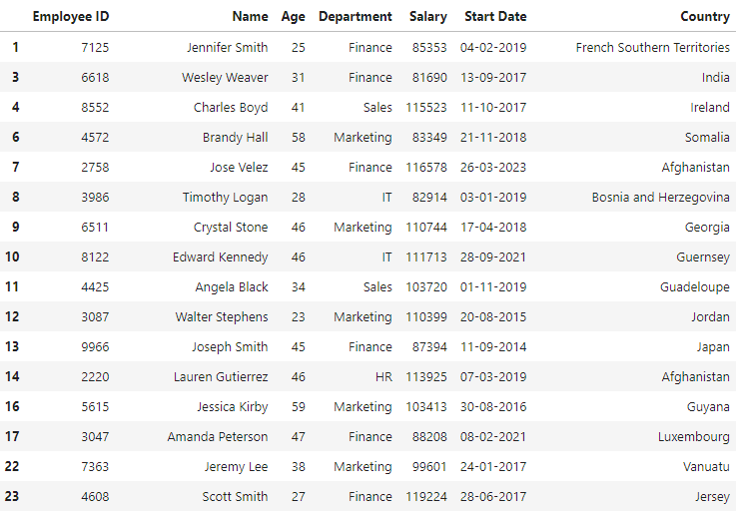
Dashboard
2.Filtering
(b) : Find all employees whose salary is greater than 80,000
Code :
Result :
Note : Due to space limit only limited record pasted.

Slide 6
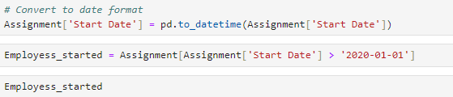
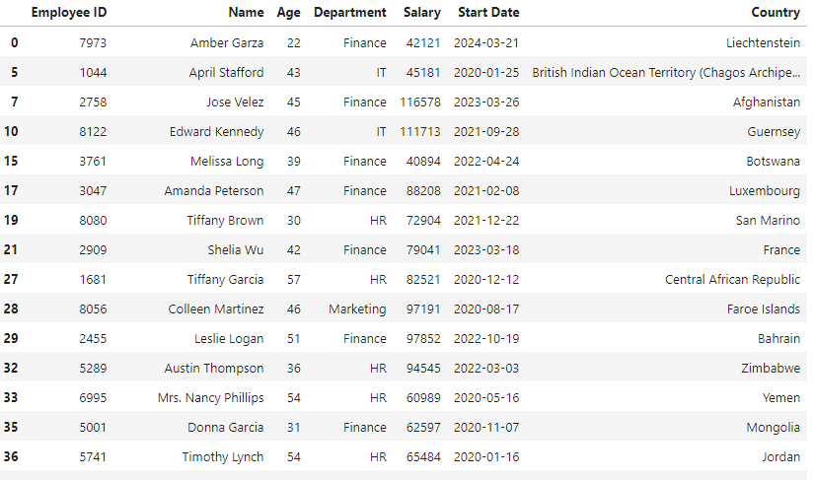
Dashboard
2.Filtering
(c) : Find all employees who started after January 1, 2020
Code :
Result :
Note : Due to space limit only limited record pasted.

Slide 7

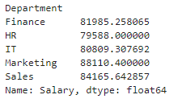
Dashboard
3. Grouping and Aggregation
(a) : Group the employees by Department and calculate the average salary of each
department
Code :
Result :

Slide 8

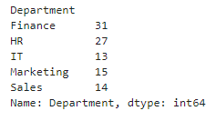
Dashboard
3. Grouping and Aggregation
(b) : How many employees are there in each department
Code :
Result :

Slide 9

Dashboard
4. Min and Max values
(a) : Identify the employees with the highest Salary, Display their Name, Department and
Salary
Code :
Result :

Slide 10


Dashboard
4. Min and Max values
(b) : Find the Youngest employee in the dataset. Display their name, Age and Department
Code :
Result :

Slide 11

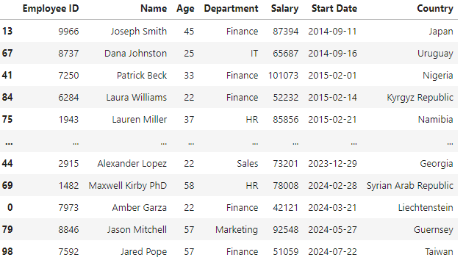
Dashboard
5. Sorting
(a) : Sort the employees by start date in ascending order, Display the Name, Start Date and
Department
Code :
Result :

Slide 12

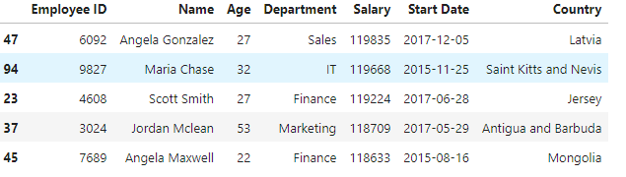
Dashboard
5. Sorting
(b) : Sort the dataset by salary in descending order and display the top 5 highest paid
employees
Code :
Result :

Slide 13




Dashboard
6. Basic statistical Analysis
(a) : Calculate the average, minimum and maximum age of the employees
Code :
Result :
Code :
Result :
Code :
Result :

Slide 14



Dashboard
6. Basic statistical Analysis
(b) : What is the average salary in the dataset? Also, find the total salary expenditure
Code :
Result :
Code :
Result :

Slide 15
Dashboard
Thank You

